Slide 1
PREDICTION OF TOXIC LEVEL IN LAVATORY AND ALERT GENERATING SYSTEM USING ANDROID APPLICATION
UNDER THE GUIDANCE OF
S.KANIMOZHI
PRESENTED BY
AKASHRAM -2019115011

Slide 2
MOTIVATION
Cleanliness is one of the most fundamental requirements to build a steady and healthy economy. This abstract focuses on a system which enables effective cleaning and maintenance of toilets by reducing .
The insight provided by the data analysis ensures a user is well equipped with the knowledge needed to make effective future decisions with confidence.
OBJECTIVE
Our aim is to monitoring the lavatory continuously using android application.
Data analysis of lavatory give us the solution to prevent the future causes.

Slide 3
NOVELTY IN PROJECT
In an existing system, the focus is towards reducing water wastage on toilets, by the implementation of automatic flusher.
They are not focussed on providing clean and hygienic toilets.
They are not worked out in analysis of that data and predicting the toxic value.
In our project,we are focussed on smart alert toilet management with mobile app and predicting the toxic value using EDA and linear regression algorithm.

Slide 4
INTRODUCTION
EDA (Exploratory Data Analysis) is a data analysis technique by which we try to understand the given data and the relationship among those data and also try to find out features , insights and anomalies from the data using statistics and graphical representation.
Regression is a Supervised learning which predicts a numeric values based on previous observed data . Regression analysis helps for statistical process of estimating the relationship among methane and time .
Android application helps to alert the concern person by checking the gas value from firebase.

Slide 5
LITERATURE SURVEY
S.no | Title | Details | Objective | Type and link
1. | The Why And How Of Exploratory Data Analysis In Python | Publisher : edureka | In this article,they have explained about Exploratory Data Analysis | https://www.edureka.co/blog/exploratory-data-analysis-in-python/
2. | A Beginner’s Guide to Exploratory Data Analysis with Linear Regression — Part 1 | Publisher : Medium | In this article,they have explained about EDA with linear regression analysis | https://blog.exploratory.io/a-practical-guide-of-exploratory-data-analysis-with-linear-regression-part-1-9f3a182d7a92

Slide 6
LITERATURE SURVEY
S.No | Title | Details | Objective | Type and link
3. | Exploratory Data Analysis(beginner) , Univariate, Bivariate and Multivariate — Habberman dataset. | Publisher : Medium | In this blog we will get an idea of Exploratory Data Analysis(EDA) using Univariate visualisations, bivariate visualisation, and multivariate visualisation and some plots. | https://medium.com/swlh/an-open-architecture-iot-washroom-e71af755f96d
4. | Smart-Alert-App | Publisher : github | This applications notifies the user when an earthquake occurs. Also, it sends a text message to close contacts on fall detection of the user. | https://github.com/mariosp/Smart-Alert-App

Slide 7




SOFTWARE TOOLS

Slide 8
METHODOLOGY
Mobile App:
1)Toilet details and employee details will be send to firebase for management.
2) Gas sensor value and Person count value will be continuously send to firebase from nodeMCU with certain time interval.
3)Android app continuously fetch that Iot data and check whether that gas value is higher than the threshold value or not,if yes,app will automatically send a message to person who is responsible at that time.

Slide 9
METHODOLOGY
Data analysis:
1)Importing Libraries & Loading Dataset
2)Data Preprocessing
3)Exploratory Data Analysis(EDA)
Univariate Analysis
Multivariate Analysis
4)Using linear regression predicting the unknown methane value of known time.

Slide 10
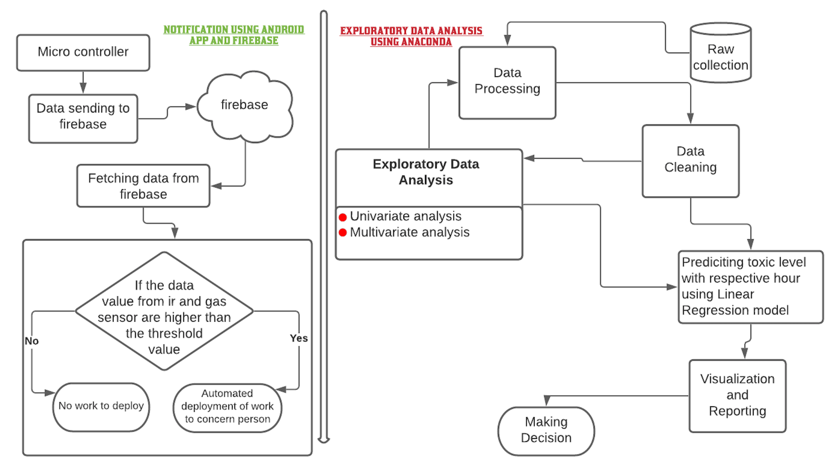
BLOCK DIAGRAM

Slide 11
Split Date into month,year,date,day,time
LIST OF MODULES
Description:
Getting month,year,date,day,time from date
Input-Output:
Segmenting date
month,year,date,day,time
Date

Slide 12
Split month into season
Description:
Getting season from month
Input-Output:
Segmenting month
Month
season

Slide 13
Split hours to timing
Description:
Getting timing from hour
Input-Output:
Segmenting hour
Hour
Timing

Slide 14
Linear regression model
Description:
Getting unknown gas sensor value for the respective known hour.
Get_cofficients used to get the slope(m)and intercept(c) values from get_variance,get_covariance,get_mean.
Input-Output:
get_varience
get_mean
Test and train data
Predicted gas value
Get_cofficient
get_covariance

Slide 15
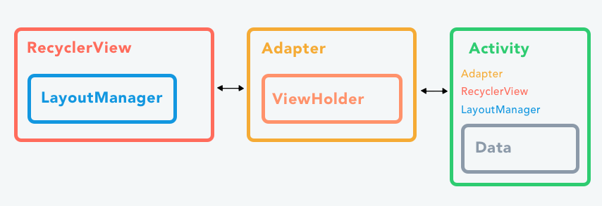
Recyclerview of dynamic data
Description:
It provides an ability to implement the horizontal, vertical and Expandable List. It is mainly used when having data collections whose elements can change at run time based on user action or any network events.
Input-Output:
Data as array of objects
Dynamically viewable at mobile application

Slide 16
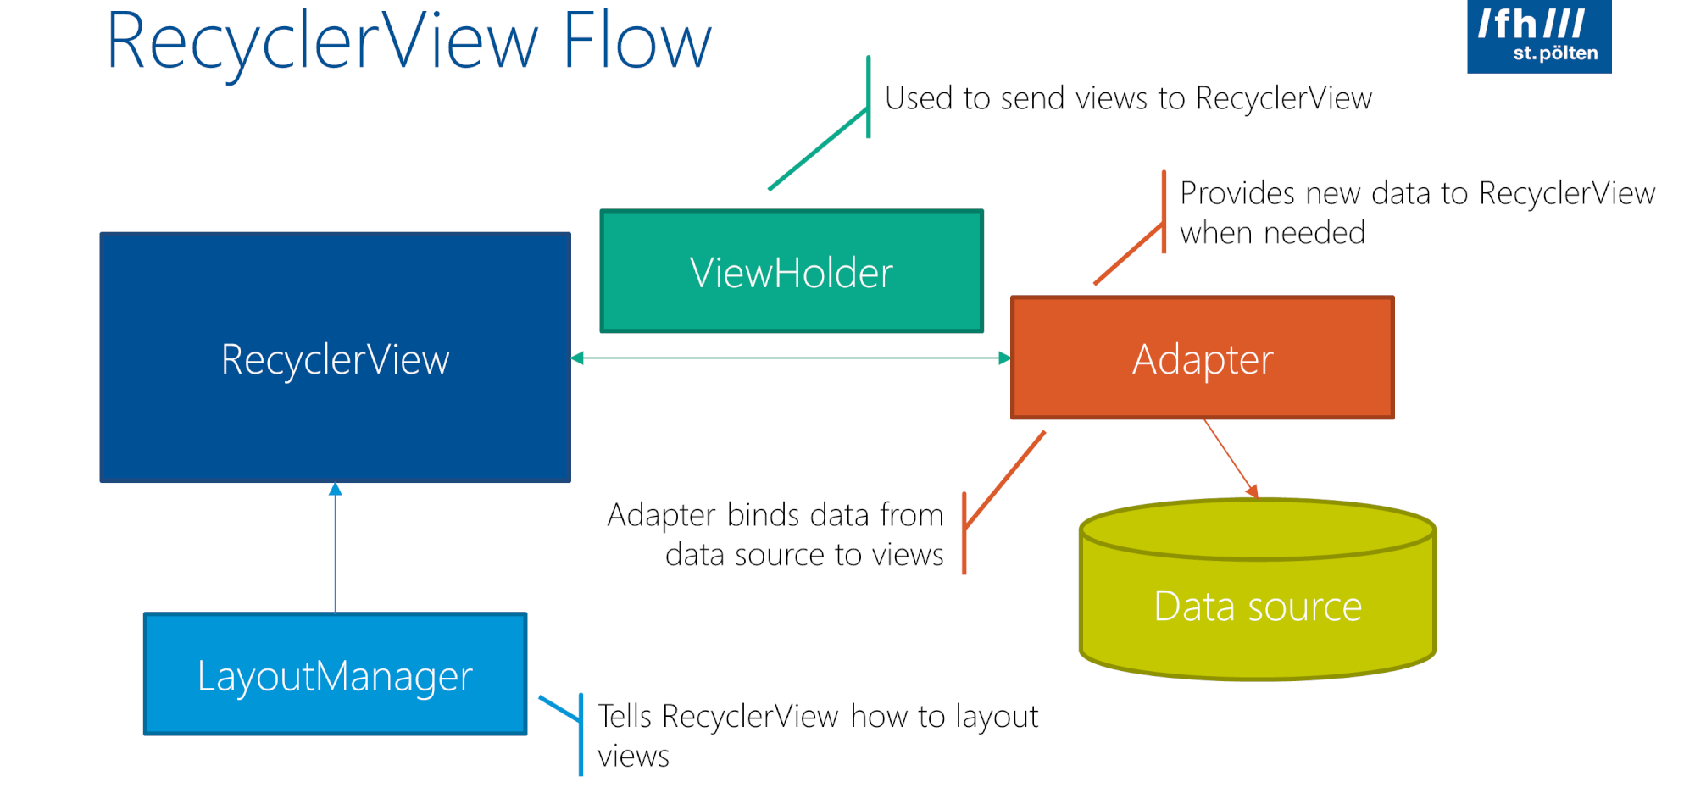

Slide 17
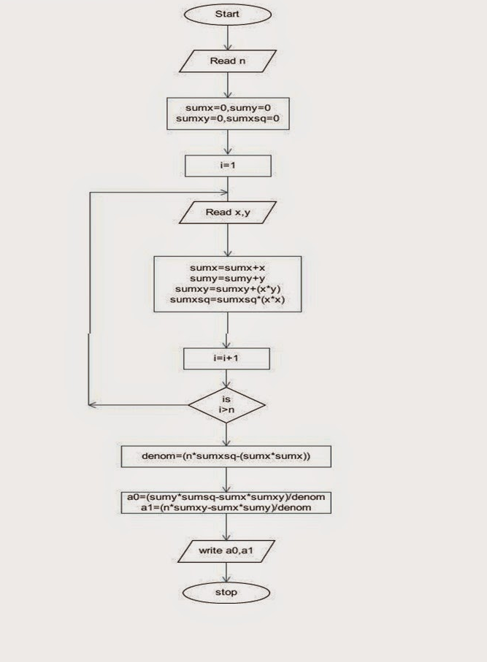
Linear Regression Algorithm
Step 1. Read n
Step 2. Sumx=0
Step 3. Sumxsq=0
Step 4. Sumy=0 Step 5. Sumxy=0
Step 6. fori=1 to n do
Step 7. Read x,y
Step 8. Sumx=sumx+x
Step 9.Sumxsq=Sumxsq+x2
Step 10.Sumy=Sumy+y
Step 11.Sumxy=sumxy+x x y end for
Step 12. denom=n x sumxsq – sumx x sumx
Step 13. a0=(sumy x sumxsq – sumx x sumxy) / denom
Step 14. a1=(n x sumxy-sumx x sumy)/ denonm
Step 15. Write a1,a0
Step 16. STOP

Slide 18
Step 1. Start
Step 2: Start get_mean(arr)
Step 3. End return np.sum(arr)/len(arr)
Step 4.End get_mean
Step 5.Start get_variance(arr, mean):
Step 6.define End return sum((arr-mean)**2)
Step 7.End get_variance
Step 8. Start get_covariance(arr_x, mean_x, arr_y, mean_y):
Step 9. define final_arr = (arr_x - mean_x)*(arr_y - mean_y)
Step 10. define End return .sum(final_arr)
Step 11. End get_covariance
Step 12. Start get_coefficients(x, y):
Step 13. define x_mean = get_mean(x)
Step 14. define y_mean = get_mean(y)
Step 15. define m = get_covariance(x, x_mean, y, y_mean)/get_variance(x, x_mean)
Step 16. define c = y_mean - x_mean*m
Step 17. return m, c
Step 18. End get_coefficients
Step 19. Start linear_regression(x_train, y_train, x_test, y_test):
Step 20.define prediction = []
Step 21.define m, c = get_coefficients(x_train, y_train)
Step 22.Start for x in x_test:
Step 23 y = m*x + c
Step 24.End loop
Step 26. prediction.append(y)
Step 27.return prediction
Step 28.End linear_regression
Step 30.define linear_regression(x[:6960], y[:6960], x[6960:], y[6960:])
Step 31. STOP

Slide 19
Linear Regression Algorithm
Step 1. Start
Step2: Start get_mean(arr)
Step 3. End return np.sum(arr)/len(arr)
Step 4.End get_mean
Step 4.Start get_variance(arr, mean):
Step 4.define End return sum((arr-mean)**2)
Step 4.End get_variance
Step 3. Start get_covariance(arr_x, mean_x, arr_y, mean_y):
Step 4. define final_arr = (arr_x - mean_x)*(arr_y - mean_y)
Step 4. define End return .sum(final_arr)
Step 4. End get_covariance
Step 4. Start get_coefficients(x, y):
Step 4. define x_mean = get_mean(x)
Step 4. define y_mean = get_mean(y)
Step 4. define m = get_covariance(x, x_mean, y, y_mean)/get_variance(x, x_mean)
Step 4. define c = y_mean - x_mean*m
Step 4. return m, c
Step 4. End get_coefficients
Step 6. Start linear_regression(x_train, y_train, x_test, y_test):
Step 4.define prediction = []
Step 4.define m, c = get_coefficients(x_train, y_train)
Step 4.Start for x in x_test:
step4. y = m*x + c
Step 4.End loop
Step 4. prediction.append(y)
Step 4.return prediction
Step 4.End linear_regression
Step 4.define linear_regression(x[:6960], y[:6960], x[6960:], y[6960:])
Step 16. STOP

Slide 20
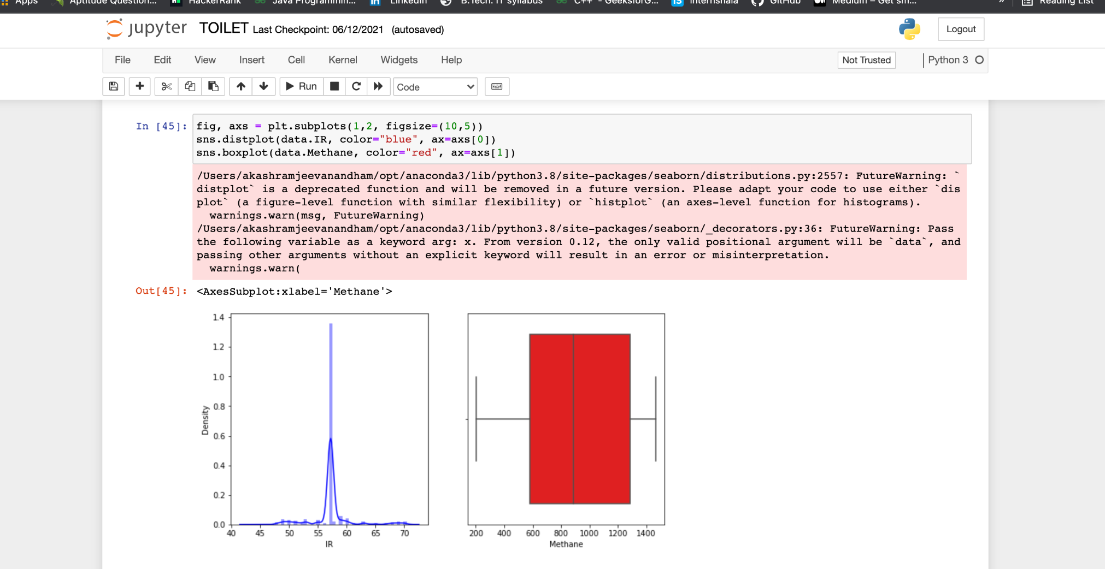
Exploratory Data Analysis(EDA)
Univariate Analysis

Slide 21
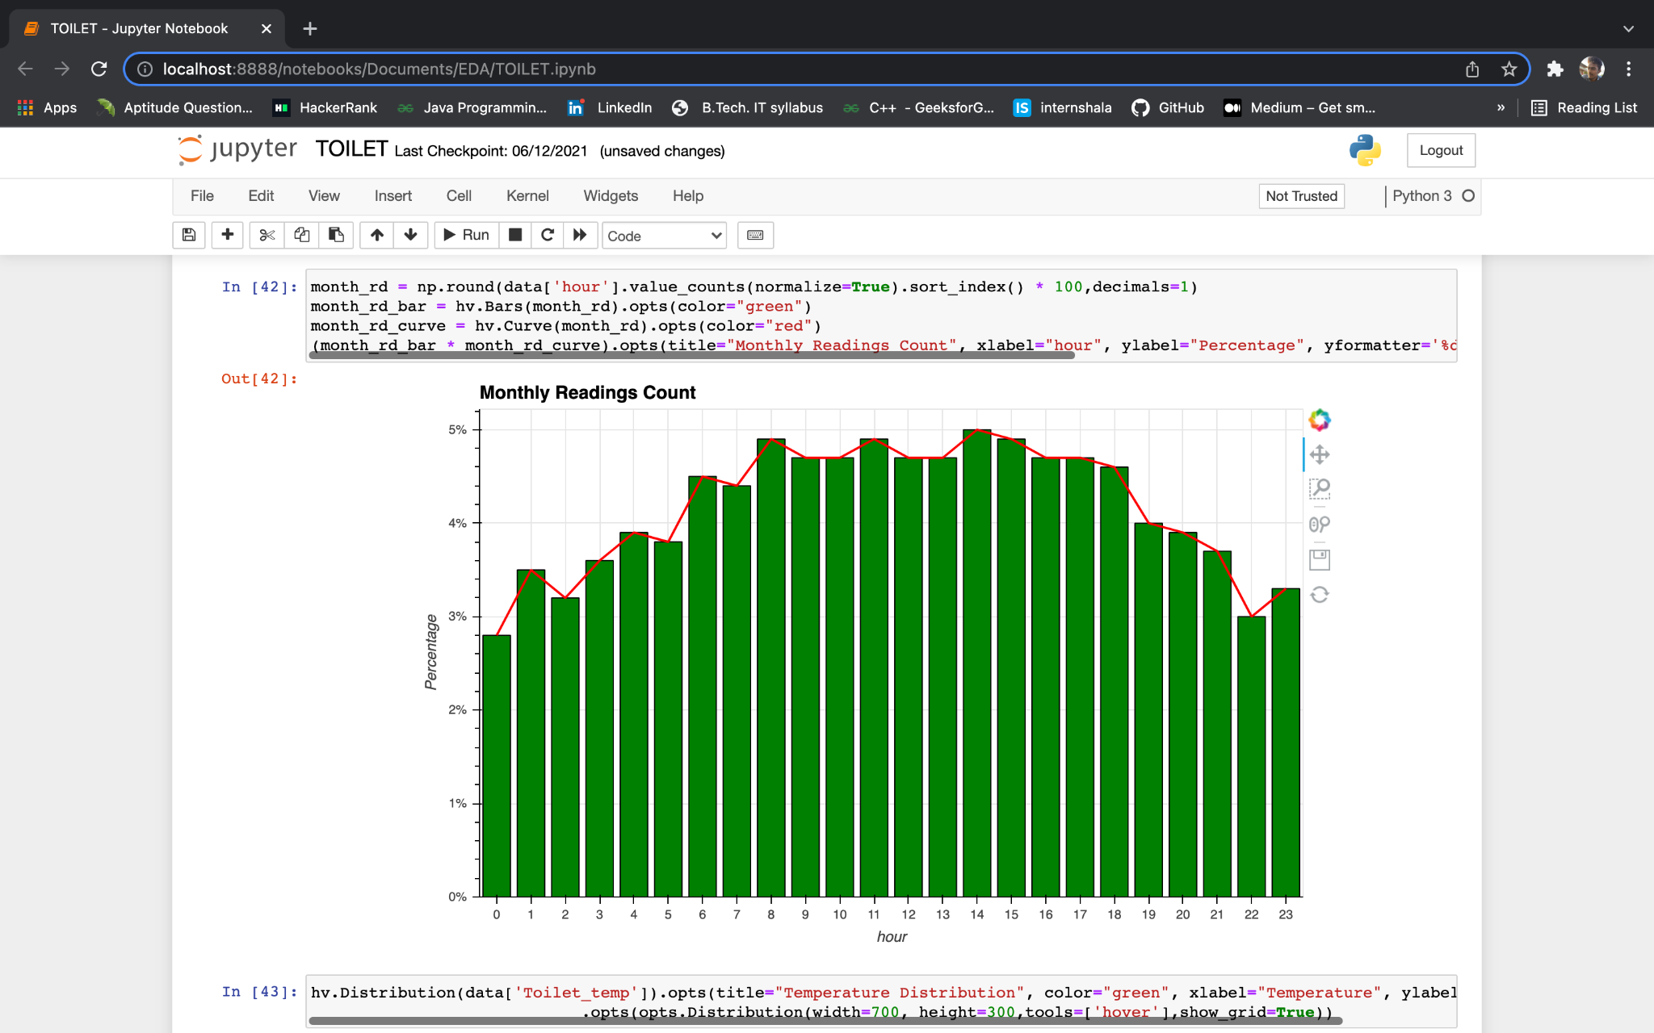
Monthly reading people count values

Slide 22
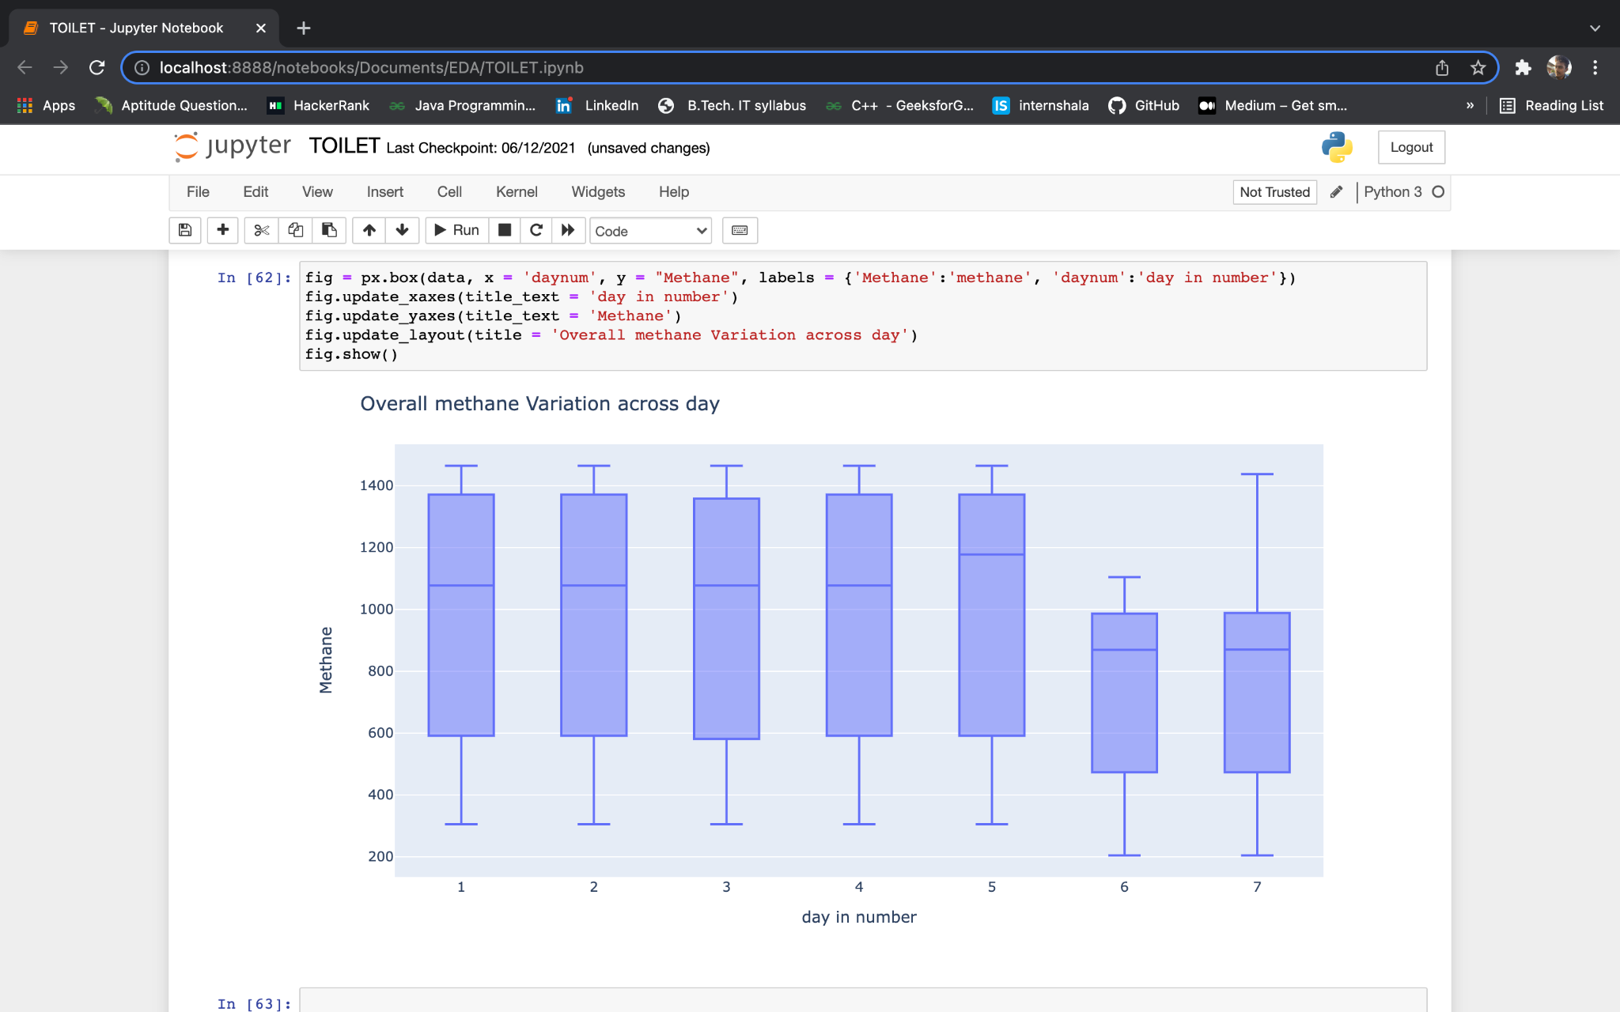
Multivariate analysis

Slide 23
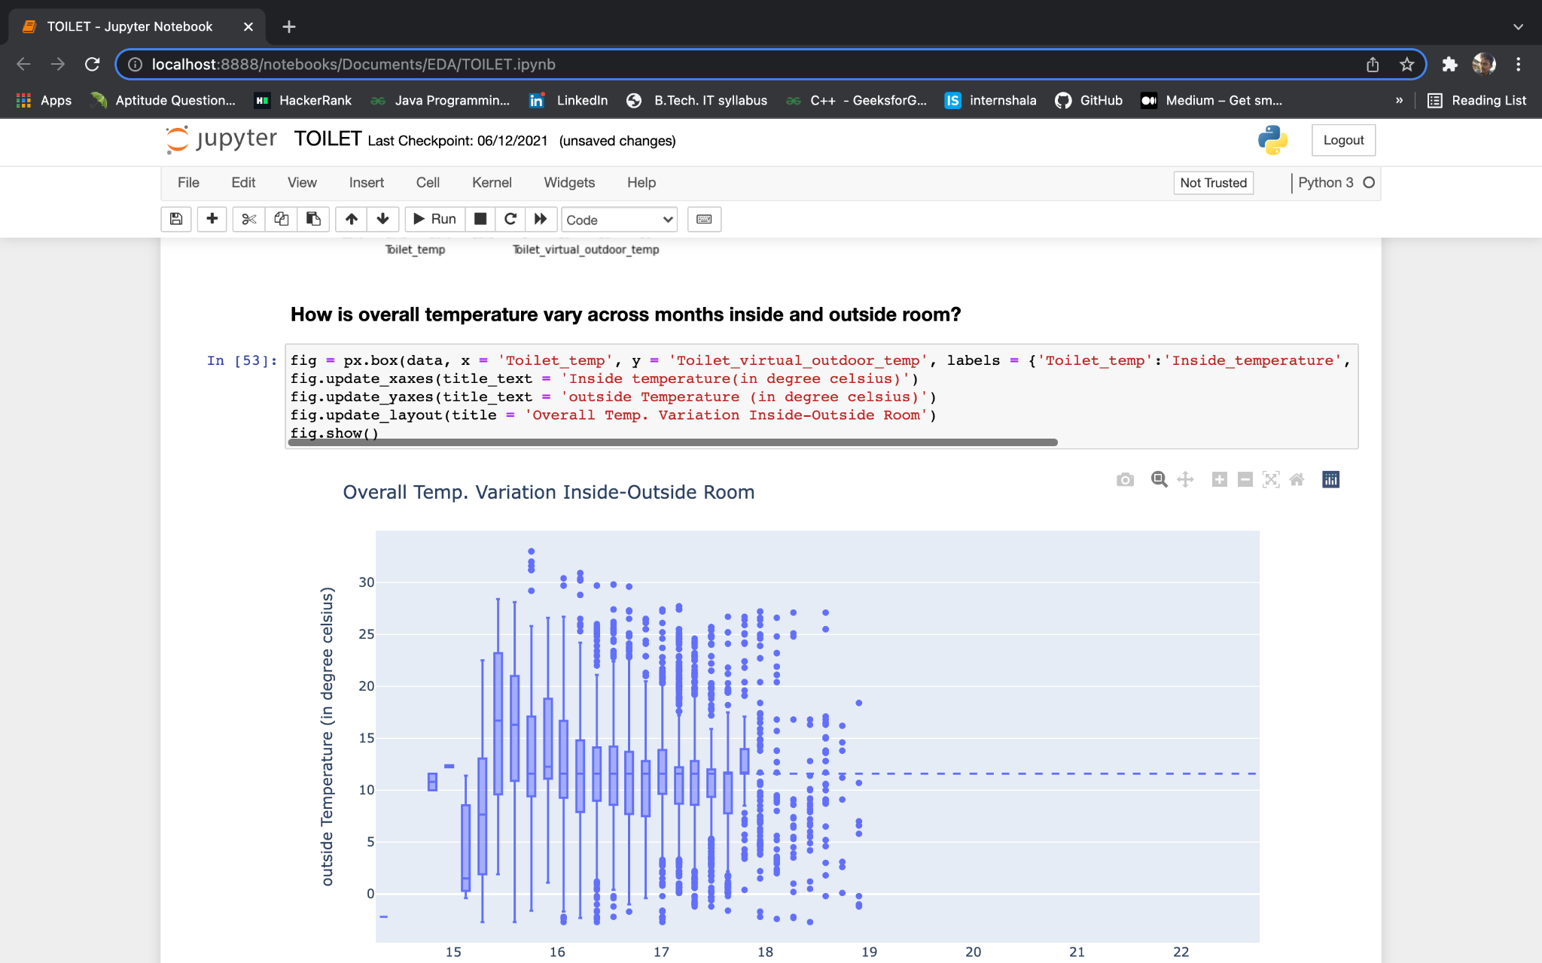
How is overall temperature vary across months inside and outside?

Slide 24
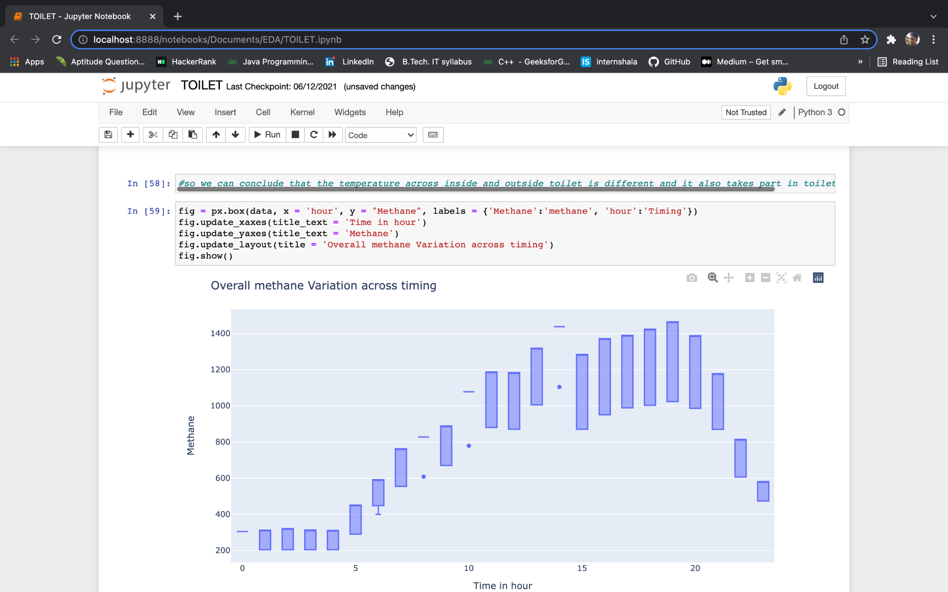

Slide 25
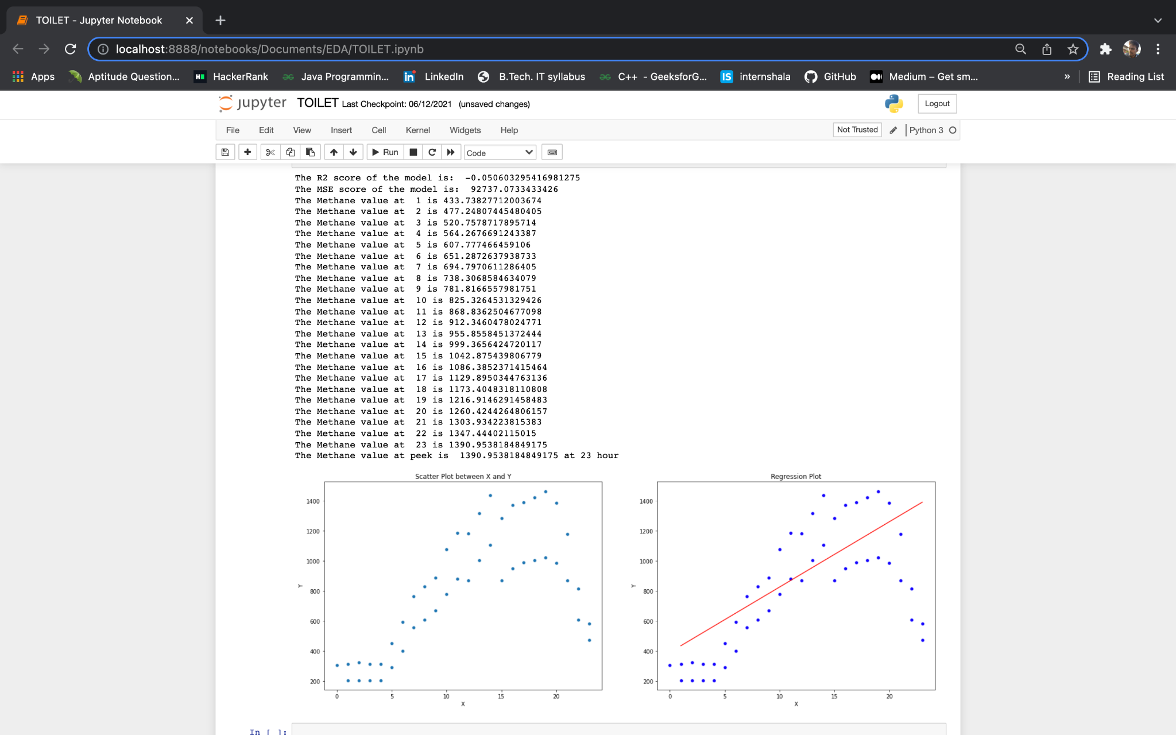
USING LINEAR REGRESSION PREDICTING THE METHANE VALUE OF RESPECTIVE HOUR:

Slide 26
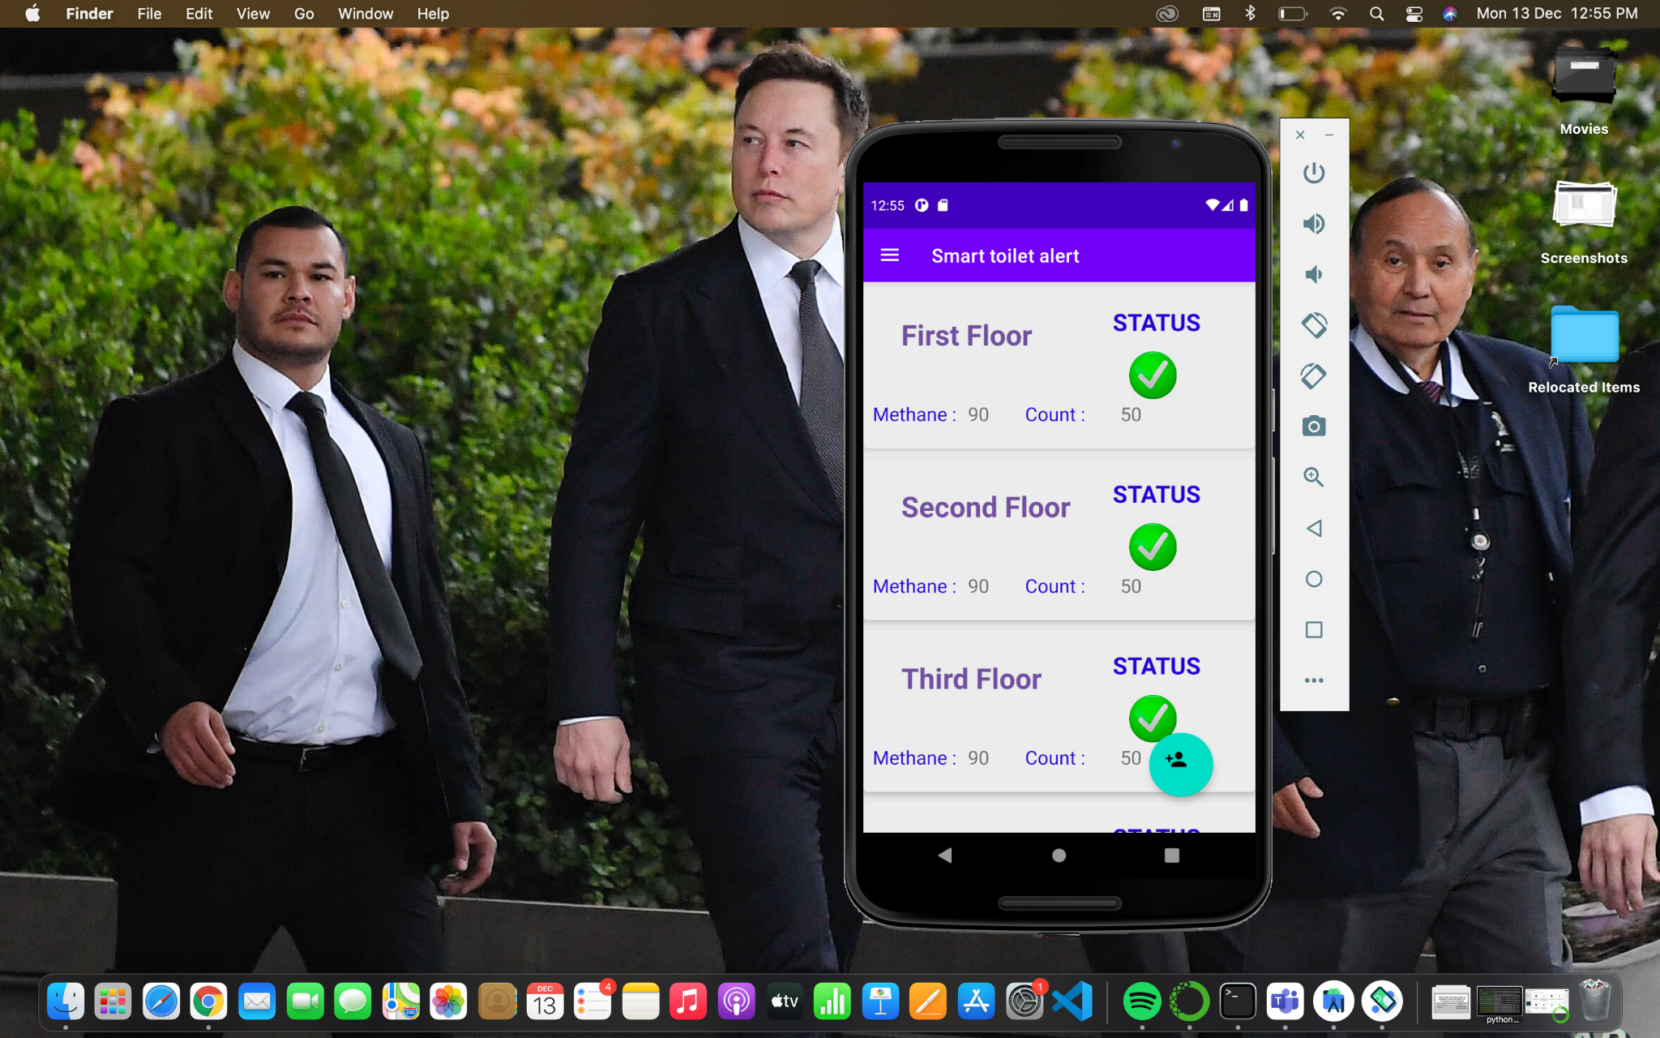
Android app screenshot

Slide 27
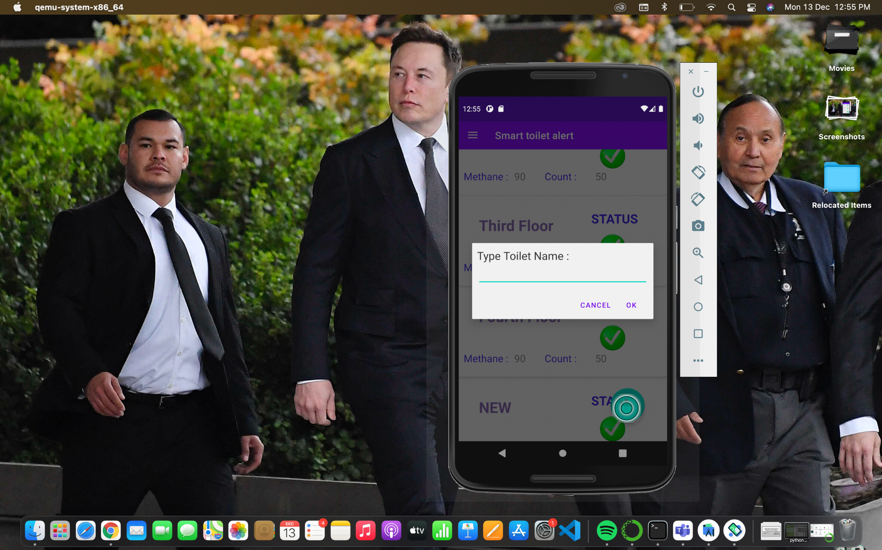

Slide 28
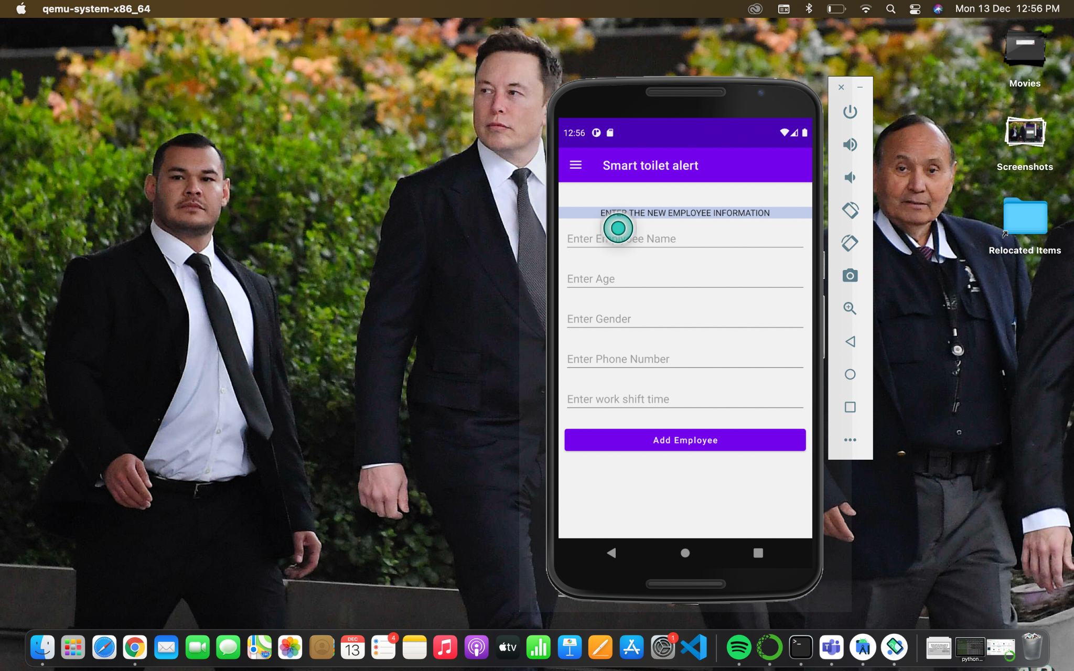

Slide 29
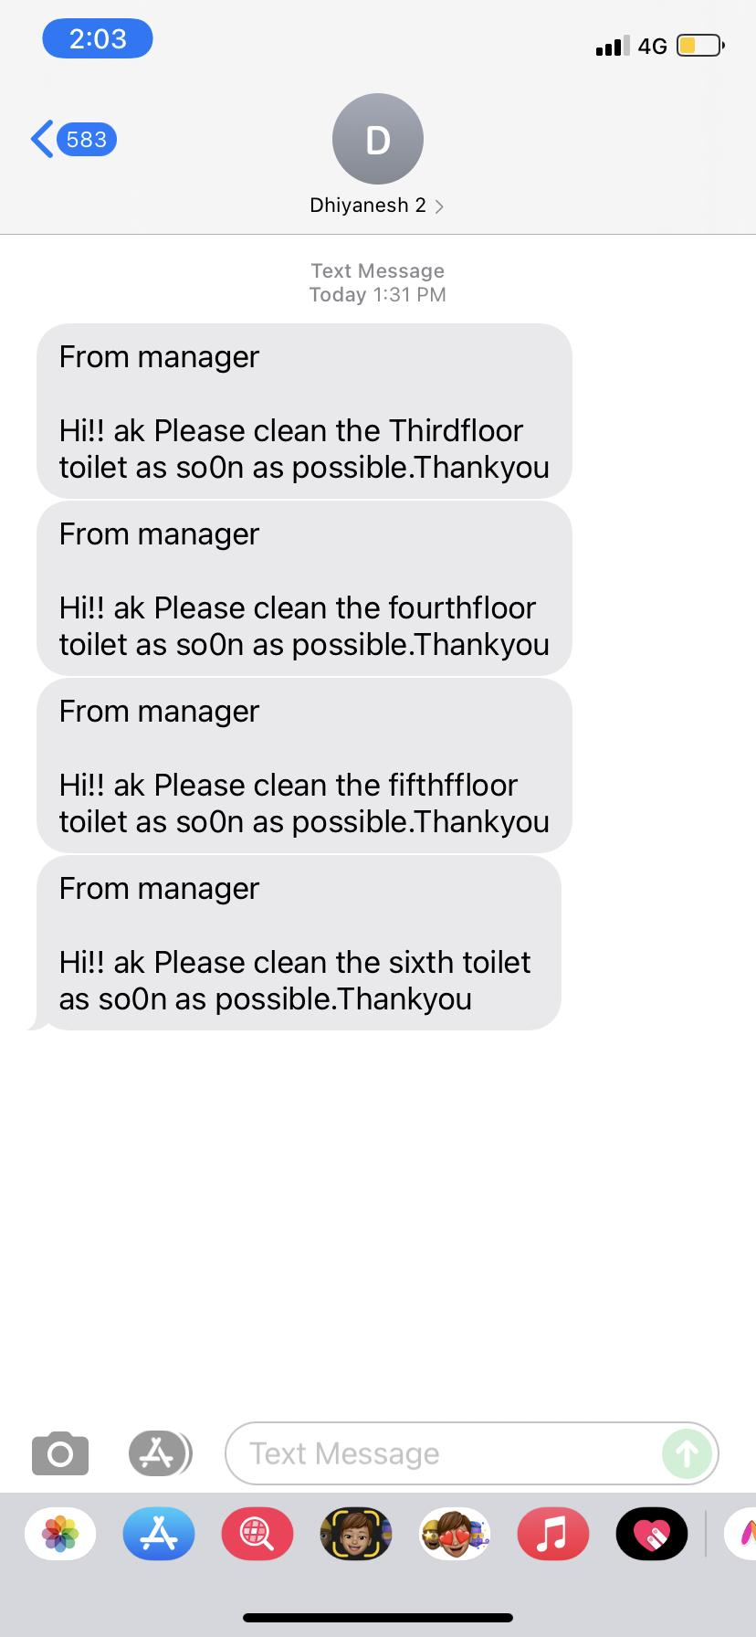
Alert message recorded in concern number

Slide 30
PROJECT OUTCOME DISCUSSION
Using android application we can alert the respective person automatically.
Data analysis of Lavatory data provide the knowledge about the lavatory and predicting the gas value of future with that prediction we can take preventive measure to avoid unhygienic condition.
This system is more helpful in the public places like mall,airport etc..

Slide 31
REFERENCES
[1] Basics about android studio, https://www.javatpoint.com/android- tutorial
[2]Android Development for Beginners - Full Course - YouTube https://www.youtube.com/watch?v=fis26HvvDII
[3] Exploratory Data Analysis (EDA) Using Python | Python Data Analysis | Python Training | Edureka https://youtu.be/-o3AxdVcUtQ
[4]Data analysis of toilet management https://thesai.org/Downloads/Volume11No5/Paper_47-IoT_Technology_for_Facilities_Management.pdf
[5]oilet-cleanliness-indicator
https://github.com/knot10120/toilet-cleanliness-indicator

Slide 32
REFERENCES
[6]STM-Smart-Toilet-Management
https://github.com/m7salam/STM-Smart-Toilet-Management
[7]Smart-Toilet
https://github.com/taifur20/Smart-Toilet

Slide 33
THANK YOU

